Slide 1
DIT 622-05 Arduino: LCD and Humidity Sensor
By Loreto Gabawa Jr.

Slide 2
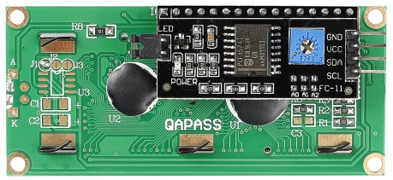
LCD 1602 with iic or i2c
16 Characters per line (row)
2 lines
You need to download the Library for this module then in the IDE go to Sketch -> Include Library -> add .ZIP library (then locate the zip file): https://drive.google.com/file/d/1wWmXZYuuzLWThirkJRqS5roA39A_zwLr/view

Slide 3
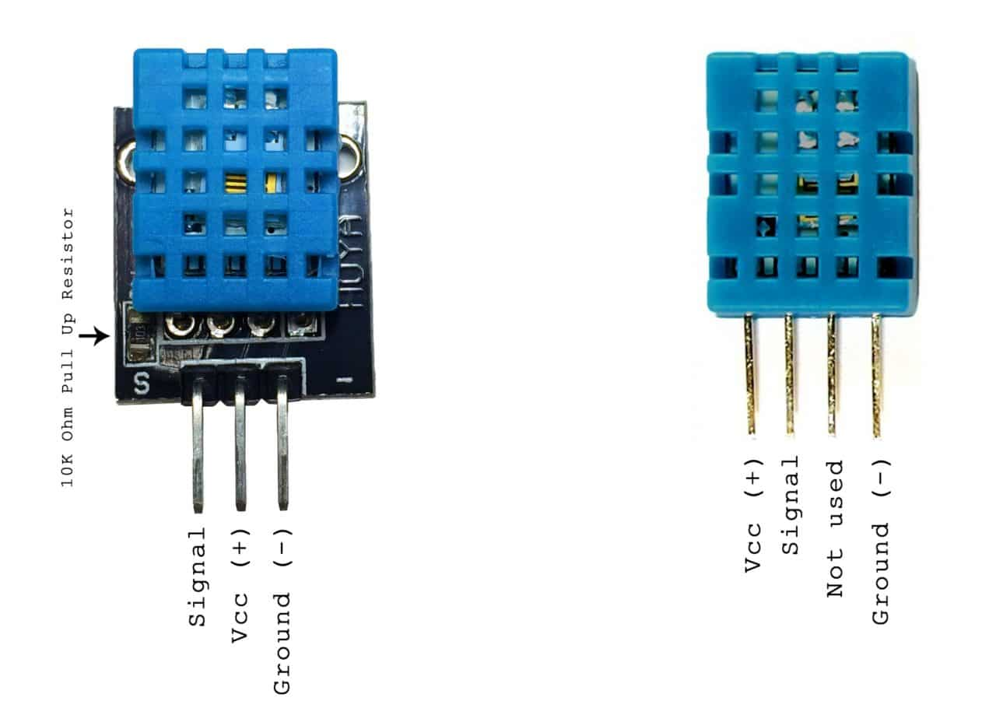
Humidity Sensor

Slide 4
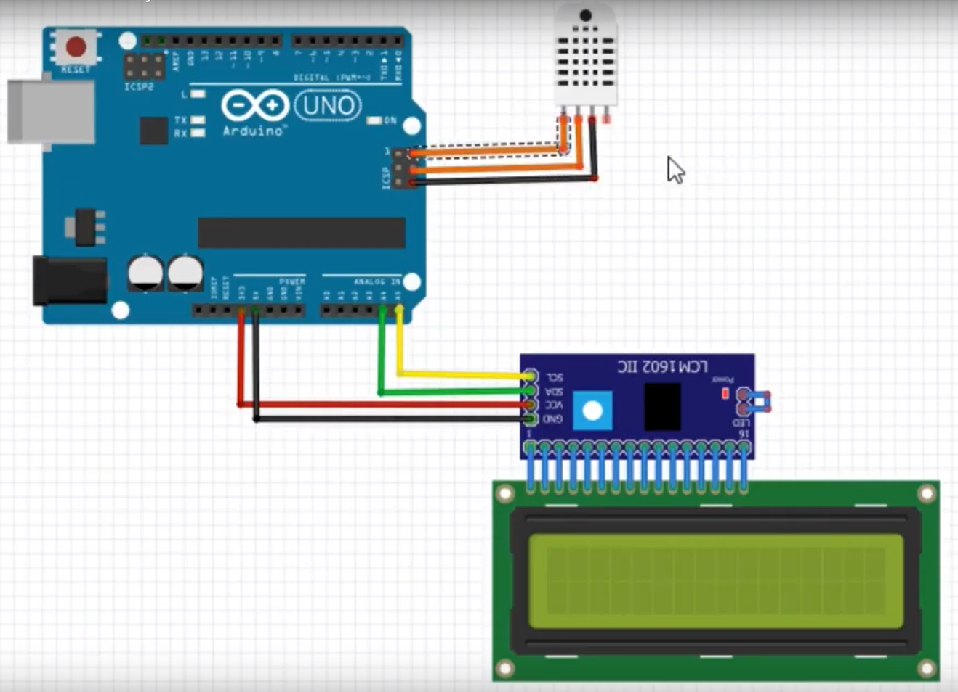

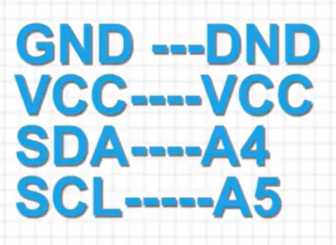
Schema

Slide 5
Function References
https://www.arduino.cc/reference/en/language/functions/

Slide 6
Function References
pinMode()
Configures the specified pin to behave either as an input or an output.
As of Arduino 1.0.1, it is possible to enable the internal pullup resistors with the mode INPUT_PULLUP. Additionally, the INPUT mode explicitly disables the internal pullups.
pinMode(pin, mode)
pin: the Arduino pin number to set the mode of.
mode: INPUT, OUTPUT, or INPUT_PULLUP.
Returns: nothing/null/void

Slide 7
Function References
digitalWrite()
Write a HIGH or a LOW value to a digital pin.
If the pin has been configured as an OUTPUT with pinMode(), its voltage will be set to the corresponding value: 5V (or 3.3V on 3.3V boards) for HIGH, 0V (ground) for LOW.
If the pin is configured as an INPUT, digitalWrite() will enable (HIGH) or disable (LOW) the internal pullup on the input pin. It is recommended to set the pinMode() to INPUT_PULLUP to enable the internal pull-up resistor.
If you do not set the pinMode() to OUTPUT, and connect an LED to a pin, when calling digitalWrite(HIGH), the LED may appear dim. Without explicitly setting pinMode(), digitalWrite() will have enabled the internal pull-up resistor, which acts like a large current-limiting resistor
digitalWrite(pin, value)
pin: the Arduino pin number.
value: HIGH or LOW.
Returns: nothing/null/void

Slide 8
Function References
pulseIn()
Reads a pulse (either HIGH or LOW) on a pin. For example, if value is HIGH, pulseIn() waits for the pin to go from LOW to HIGH, starts timing, then waits for the pin to go LOW and stops timing. Returns the length of the pulse in microseconds or gives up and returns 0 if no complete pulse was received within the timeout.
The timing of this function has been determined empirically and will probably show errors in longer pulses. Works on pulses from 10 microseconds to 3 minutes in length.
pulseIn(pin, value) or pulseIn(pin, value, timeout)
pin: the number of the Arduino pin on which you want to read the pulse. Allowed data types: int.
value: type of pulse to read: either HIGH or LOW. Allowed data types: int.
timeout (optional): the number of microseconds to wait for the pulse to start; default is one second. Allowed data types: unsigned long.
Return: The length of the pulse (in microseconds) or 0 if no pulse started before the timeout. Data type: unsigned long.

